Slide 1
House Price Prediction
Juhi Mene

Slide 2
Problem Statement
To develop a machine learning model capable of accurately predicting house prices based on various features such as location, sizes, number of bedrooms and bathrooms, etc.

Slide 3
Flow Chart
Data Collection
Data Cleaning
Datatype Conversion
EDA (Outliers and skewness treatment)
Basic Data frame 1
Visualisation
Data frame 2
Feature Selection
Final Data frame

Slide 4
Data Cleaning
Data type Conversion
Missing Value Treatment

Slide 5
Basic Data frame
Sr. no. | Model name | R-square | Adj-r2 | MSE
0 | Linear | 0.876876 | 0.868412 | 2.157555e+09
1 | Lasso | 0.876876 | 0.868412 | 2.158193e+09
2 | Ridge | 0.876814 | 0.868346 | 2.160128e+09
3 | RF | 0.979594 | 0.978191 | 9.418067e+08
4 | XGB | 0.999887 | 0.999879 | 7.172927e+08
The conclusion from above data frame is “XGB Regressor” is best suited model for my data.

Slide 6
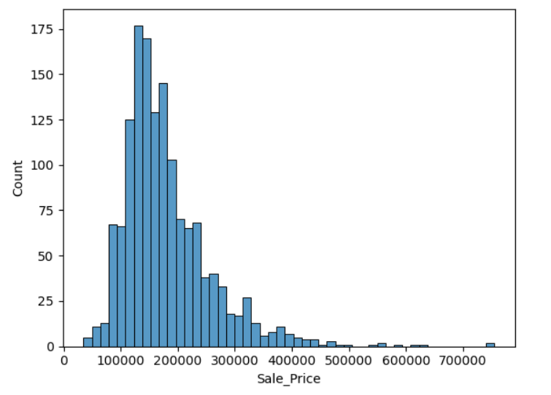
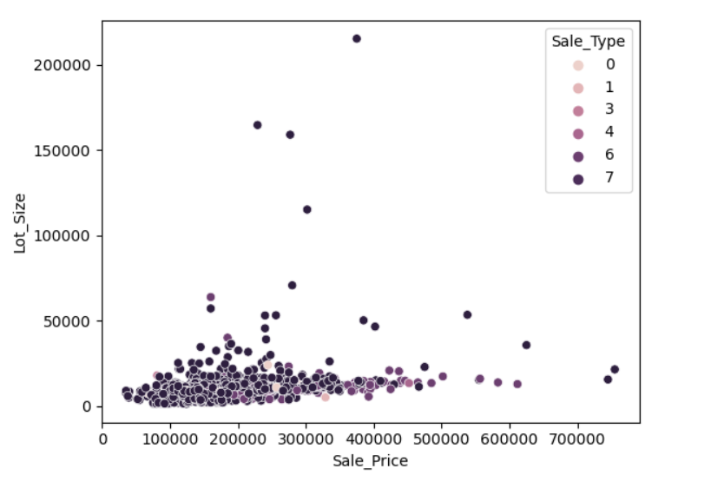
Visualization
This graph shows histogram of 'Sale Prices' which indicates frequency of different price ranges.
This is scatter plot which shows the relationship between property sale prices and lot sizes.

Slide 7
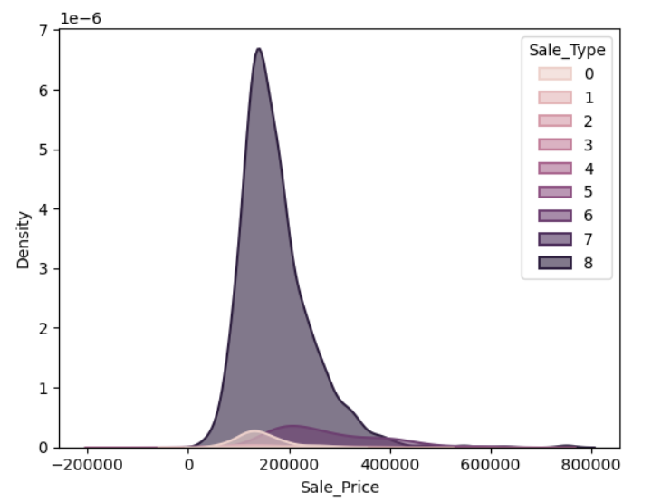
This plot is kernel density estimation plot that shows distribution of sale prices across different sale type.

Slide 8
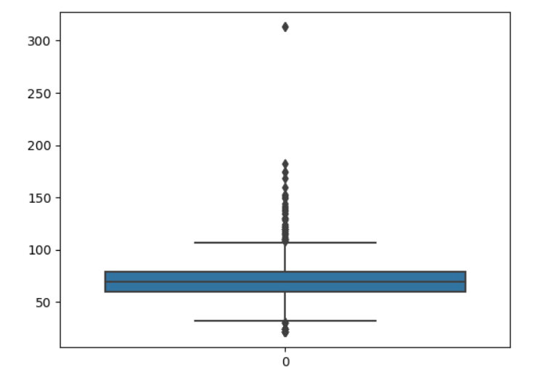
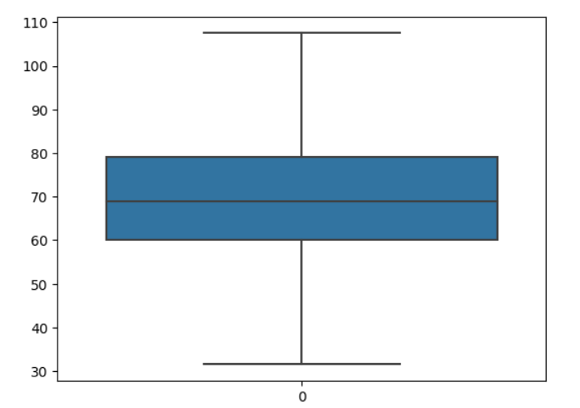
Outlier treatment
Boxplot of column “ Lot_Extent ”
before treating outliers.
Boxplot after treating outliers.

Slide 9
Data frame 2
Sr. No. | Model name | R-square | Adj-R2 | MSE
0 | Linear | 0.878856 | 0.870647 | 5.849448e+08
1 | Lasso | 0.878637 | 0.870413 | 6.350080e+08
2 | Ridge | 0.878811 | 0.870599 | 5.855896e+08
3 | RF regressor | 0.980810 | 0.979510 | 8.362515e+08
4 | XGB | 0.999887 | 0.999879 | 6.233105e+08

Slide 10
Feature Selection using lasso coefficient.

Slide 11
DATA FRAME 3
Sr. No. | Model name | R-square | Adj-R2 | MSE
0 | Linear | 0.878856 | 0.870647 | 5.849448e+08
1 | Lasso | 0.878637 | 0.870413 | 6.350080e+08
2 | Ridge | 0.878811 | 0.870599 | 5.855896e+08
3 | RF regressor | 0.980810 | 0.979510 | 8.362515e+08
4 | XGB | 0.999887 | 0.999879 | 6.233105e+08
5 | F_S | 0.878849 | 0.870875 | 5.850069e+08
The conclusion from above data frame is “Linear” is best suited model for my data as it’s MSE is low as compared to other models.

Slide 12
Merits
Interpretability: Linear models are simple and easy to interpret.
Ease of Implementation: Linear models are straightforward to implement and deploy.
Less Prone to Overfitting: Linear models are less prone to overfitting, especially when the number of observations is much larger than the number of features.
Regularization: Techniques like Lasso and Ridge can be applied to linear models to prevent overfitting.

Slide 13
Demerits
Advanced models like XG Boost may require more sophisticated data preprocessing techniques compared to linear models.
Without proper parameter tuning and regularization, other complex models can be prone to overfitting, especially when dealing with small or noisy datasets.
Complex models may require more maintenance over time, especially in dynamic real estate markets where factors affecting house prices may change.
Increasing the complexity of the model may not always result in proportional improvements in predictive performance.

Slide 14
THANK YOU

